Slide 1
Bandit –
A Wargame For Linux Beginners
Lab-3

Slide 2
Bandit Level 10 → Level 11
Level Goal
The password for the next level is stored in the file data.txt, which contains base64 encoded data
Commands you may need to solve this level
grep, sort, uniq, strings, base64, tr, tar, gzip, bzip2, xxd

Slide 3

I log in and again I have this data.txt. This time it is base64-encoded. So I have to decode it. There is a tool for this surprisingly called base64. There is the flag -d for decoding. So all I have to do is the following.
Solution
base64 -d data.txt
The password is 6zPeziLdR2RKNdNYFNb6nVCKzphlXHBM

Slide 4
Bandit Level 11 → Level 12
Level Goal
In the home directory, a file named data.txt can be located. When this file is extracted, it reveals a sequence of characters that appears to be nonsensical. The hint provided in the level’s objective suggests that the text has undergone transformation through the rot-13 cipher, a substitution cipher that rotates characters by 13 positions.
The data.txt file contains 1 line that was encrypted with the ROT13 algorithm. In order to decrypt it, I have to replace every letter with the letter 13 positions ahead. For example, with this encryption, the letter a would be replaced with n. The word banana would encrypt to onanan. To decrypt the line, I ran the command below:

Slide 5
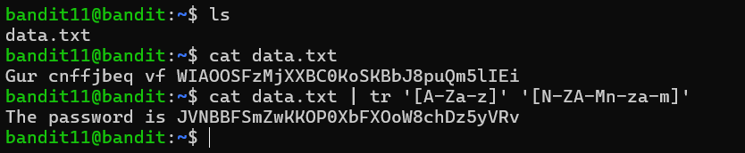
This command reads a file, shifting letters by 13 positions in the alphabet (ROT13 cipher).
cat data.txt | tr '[A-Za-z]' '[N-ZA-Mn-za-m]'
The command above send the line to stdout where tr shifts every letter 13 positions. After running that command, the output was:
Username: bandit12
Password : JVNBBFSmZwKKOP0XbFXOoW8chDz5yVRv

Slide 6
Bandit Level 12 → Level 13
The password for the next level is stored in the file data.txt, which is a hexdump of a file that has been repeatedly compressed. For this level, it may be useful to create a directory under /tmp in which you can work using mkdir.
Commands you may need to solve this level
grep, sort, uniq, strings, base64, tr, tar, gzip, bzip2, xxd, mkdir, cp, mv, file
A little bit of Theory
mkdir <path> can be used to create a new directory.
cp <source> <destination> copies files.
mv <source> <destination> moves or renames files.

Slide 7
Hexdumps are often used when we want to look at data that cannot be represented in strings and therefore is not readable, so it is easier to look at the hex values. A hexdump has three main columns. The first shows the address, the second the hex representation of the data on that address and the last shows the actual data as strings (with ‘.’ being hex values that cannot be represented as a string). Many hex editors exist just pick the one you like most.
For the command line xxd can be used. xxd <input_file> <output_file> creates hexdumps. When using the -r flag, it reverts the hexdump.
In the home directory, you will discover a file named data.txt. Given that this file necessitates multiple transformations, establish a fresh directory within /tmp/, for instance: mkdir /tmp/txone1. Subsequently, employ the cp command to duplicate the data.txt file into the newly created directory and employ mv (read the manpages!) to rename it.

Slide 8
After completing these initial steps, navigate to the newly created directory within /tmp/. When you inspect the contents of the data.txt file using the cat command, it will display a hexadecimal dump. To reverse this hex dump, use the xxd command with the ‘-r’ switch and pipe the output into a new file named data.
To ascertain the file type of data, use the ‘file’ command. It should indicate that data is a gzip compressed archive. To extract its contents, utilize the gunzip command and pipe the output into a file named data02. Examine the file type of data02 using the ‘file’ command again; this time, it should reveal that it is a bzip2 archive. To extract its contents, employ the bunzip2 command and pipe the result into data03. When you check the file type of data03, it should indicate that it is yet another gzip archive. Extract the contents of data03 to obtain data04, which is a Posix tar archive. Use the ‘tar’ command with the ‘-xf’ switch to extract the contents from data04. Inside data04, you will find a new file named data5.bin.

Slide 9
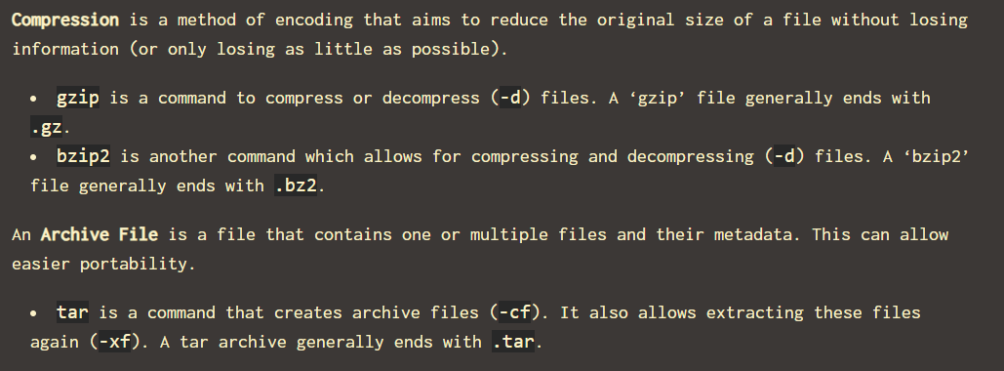
Repeat this process a few more times until you identify a file that is identified as ASCII text by the ‘file’ command. The content of this particular file will contain the key for level 13.

Slide 10
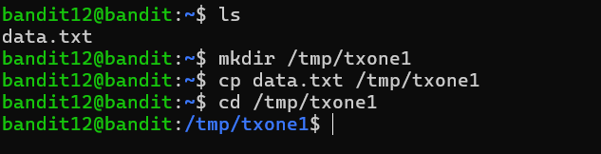
Solution
Create Directory and Move file

Slide 11
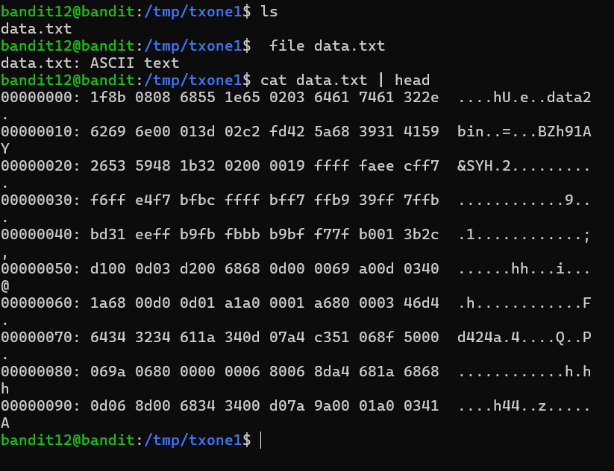
The actual data looks like this when printed to the console:

Slide 12

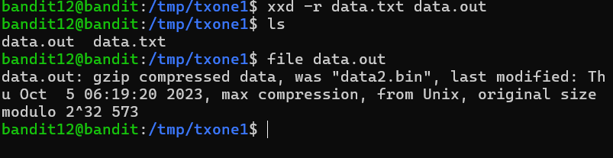
use the xxd command with the ‘-r’ switch and pipe the output into a new file named data

Slide 13
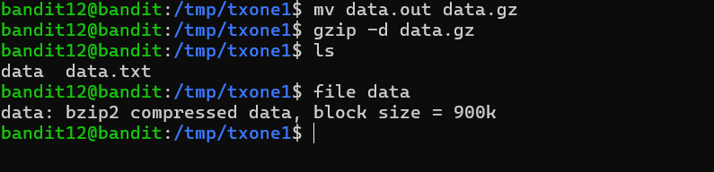
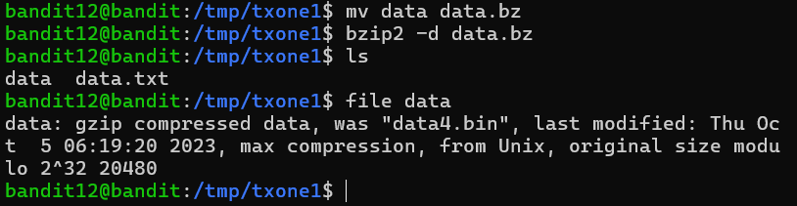
Now we can add the correct file ending, by renaming the file and decompress the file with gzip -d:

Slide 14
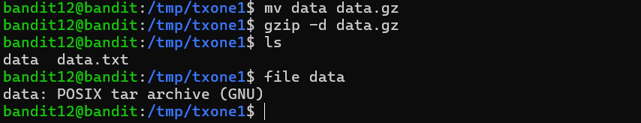
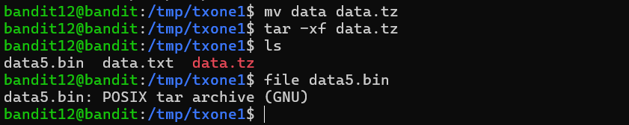
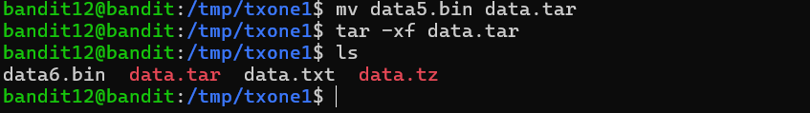

Slide 15
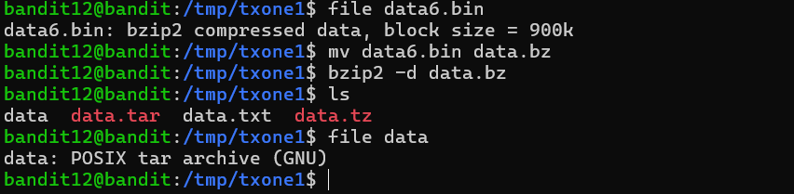
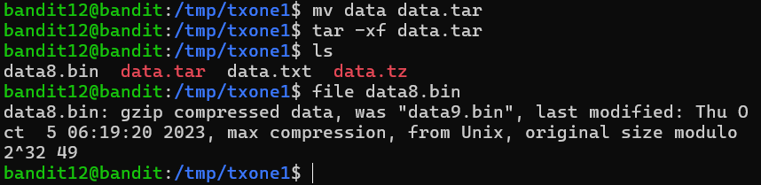

Slide 16
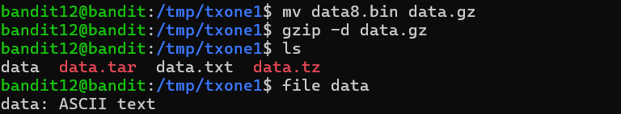
The password is wbWdlBxEir4CaE8LaPhauuOo6pwRmrDw

Slide 17
THANK YOU

